Slide 1
DIGITAL PHENOTYPING and more

Slide 2
Digital Phenotyping
1
2
Raw Data eg log files
Analytics App usage, screen time, consistency
Prediction
ML models
Indicators
(of depression/
stress)
4
3
Notes:
Can be an app as well, look into that Analytics → preprocessing from preprocessing, 2 possible chains 1 chain is analytics, 2nd chain is prediction

Slide 3
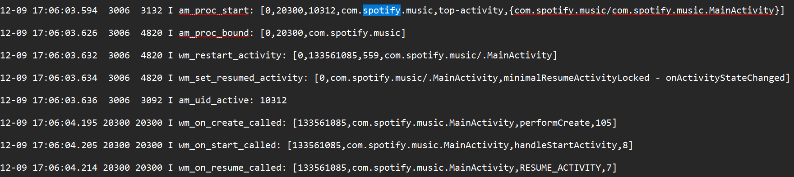
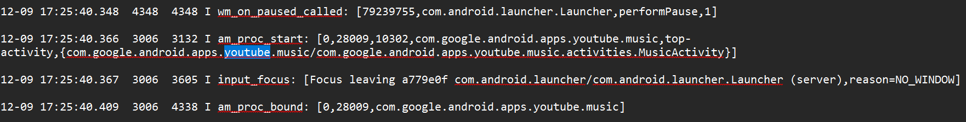
Raw Data
→ Log files

Slide 4
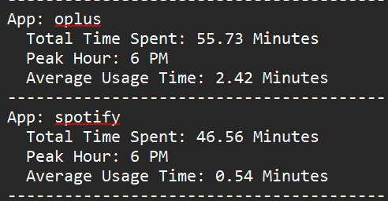
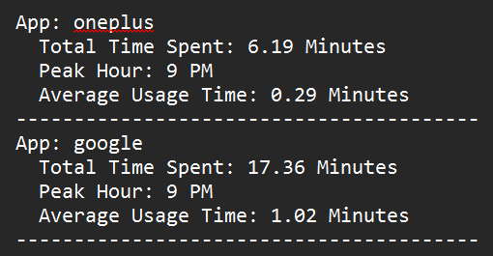
Analysis
→ App usage patterns, screen time, responsiveness, etc.
Notes:
We can get much more from log files adb access vs monitoring app scope

Slide 5
Behavioural Indicators
→ Predict Personality traits and behavioural patterns which can in turn indicate stress/anxiety/depression symptoms.
A standard can be the Big 5 personality traits
Extraversion
Agreeableness
Conscientiousness
Emotional Stability
Intellect/Imagination
References : When phones get personal: Predicting Big Five personality traits from application usage [2020 paper]
Lee et al. investigate the dark patterns in smartphone usage and covers socially anxious behavior, materialism, and the compulsive use of smartphones. Takao et al. link smartphone usage to addictive behavior, and several other authors link smartphone usage to mental health, especially depression

Slide 6
Behavioural Indicators
→ Predict Personality traits and behavioural patterns which can in turn indicate stress/anxiety/depression symptoms.
Extroverts preferring less use of internet, games, and camera applications
Agreeable users using hardly any apps
Conscientiousness correlating negatively to the music apps
Emotional stability correlating negatively to the office and calendar apps
Openness correlating widely negatively to multiple app categories.
Reference : Chittaranjan et al., Mining large-scale smartphone data for personality studies, [2013]
Notes:
citations

Slide 7
Predicting Depression
→ Personality traits and behavioural patterns can be correlated with symptoms of depression/stress
Previous work : Asare et al. Predicting Depression From Smartphone Behavioral Markers Using Machine Learning Methods, Hyperparameter Optimization, and Feature Importance Analysis: Exploratory Study [2021]
Attempts to predict depression based on digital biomarkers.
Explores the relationship between digital biomarkers and depression severity with statistical methods.
Used Supervised Learning ML models on this data for the predictions.
Notes:
The study takes digital biomarkers and mental health assessment (PHQ-8), and then finds the correlation. Biomarkers – location, app usage, etc.

Slide 8
Predicting Depression
→ Personality traits and behavioural patterns can be correlated with symptoms of depression/stress
Previous work : Beames et al. Use of smartphone sensor data in detecting and predicting depression and anxiety in young people (12–25 years): A scoping review [2024]
A review of research works on Digital Phenotyping.
Studies 35 papers.
Current studies use statistics and ML algorithms to correlate digital biomarkers and depression/anxiety.
Maximum accuracies reached up to 90%.
Studies have different and limited contexts.
Lack of generalized framework.

Slide 9
1
2
Raw Data eg log files
Analytics App usage, screen time, consistency
More Data
eg. Location
Indicators
(of depression/
stress)
Prediction
ML models
4
3
More Predictions
Maybe Like a personality chart
Notes:
Step 3 – long term step 4 – short term
Collect data from people [at least 10]

Slide 10
Much more to explore !

